Slide 1
EAST WEST INSTITUTE OF TECHNOLOGY DEPARTMENT OF ARTIFICIAL INTELLIGENCE AND DATA SCIENCE
PROJECT RESENTATION ON
HATE SPEECH DETECTION SYSTEM USING DEEP LEARNING AND NLP
PRESENTED BY: GUIDE
BHAVANA K MR.VINAYAK S
NISARGA R (DEPARTMENT OF ISE AND AI&DS)
SAHAANA V
VAISHALI P

Slide 2
TABLE OF CONTENTS
ABSTRACT
INTRODUCTION
LITERATURE SURVEY
EXISTING SYSTEM
PROPOSED SYSTEM
IMPLEMENTATION
RESULT
APPLICATION
CONCLUSION & FUTURE SCOPE

Slide 3
ABSTRACT
Detecting hate speech on social media is of utmost importance due to its potential to cause significant harm to society. Uncontrolled hate speech can lead to grave consequences and disproportionately affect marginalized individuals and groups.
Hate speech is considered one of the most dangerous activities on platforms like YouTube, Facebook, and Twitter. It can incite violence, discrimination, and hatred, making it crucial to address.
The project employs a hybrid approach, combining two powerful techniques - natural language processing (NLP) and ensemble machine learning. This fusion of methodologies enhances the accuracy and effectiveness of hate speech prediction.
To implement the hate speech detection, Long Short-Term Memory (LSTM) algorithms, a type of recurrent neural network known for handling sequential data. These LSTMs are used in combination to build a robust and accurate hate speech detection system..

Slide 4
INTRODUCTION
Hate crimes are unfortunately nothing new in society. However, social media and other means of online communication have begun playing a larger role in hate crimes. For instance, suspects in several recent hate-related terror attacks had an extensive social media history of hate related posts, suggesting that social media contributes to their radicalization.
Detecting hate speech is a challenging task as First, there are disagreements in how hate speech should be defined. This means that some content can be considered hate speech to some and not to others, based on their respective definitions. Some recent studies claimed favorable results to detect automatic hate speech in the text. The proposed solutions employ the different feature engineering techniques and ML algorithms to classify content as hate speech

Slide 5
Problem Statement: “To implement hate speech detection system which classifies code-mix hate speech into multi-class using NLP and ensemble techniques.”
Code-mixing is complex, and detecting hate speech within it is challenging due to linguistic diversity and nuances.
The project aims to create an advanced algorithm to categorize code-mix hate speech, including harmful stereotypes, insulting language, targeted hate, and potentially more, based on the specific hate speech types found.
The project aims to enhance the system's accuracy and robustness by utilizing ensemble models and NLP techniques.
Ethical considerations, including fairness, bias prevention, and preserving freedom of expression, are vital when developing and implementing this system to address hate speech without inadvertently suppressing valid discourse.

Slide 6
Objectives:
To minimize the misclassification rate.
To build an efficient system to accurately detect and classify hate speech.
To design a desktop application that categorize the entered user comment.
To implement Ensemble Machine Learning approach to obtain precise results.
Strive to contribute to a safer and more inclusive online community by achieving these research objectives.

Slide 7
Literature survey
S. no | Year | Paper Title | Author | Algorithm used | Merits | Demerits
1 | 2021 | "Deep Multi-modal Hate Speech Detection in Twitter" | Vidros, Spyros, et al. | Convolutional Neural Networks (CNN) and Long Short-Term Memory Networks (LSTM) | Contributes to addressing online hate speech by employing multi-modal deep learning techniques, enhancing accuracy and robustness. | Requires multimodal data (text and images), which may not always be available
2 | 2021 | "Multimodal Hate Speech Detection in Videos" | Agrawal, Harsh, et al | Deep Learning (Combination of Convolutional Neural Networks and Long Short-Term Memory Networks) | Offers valuable insights into combating hate speech in multimedia content, addressing a pressing issue in online communication. | Requires access to video data, which may not always be available
3 | 2021 | “Hate Speech on Twitter: A Pragmatic approach to collect hateful and offensive expression and perform hate speech detection” | Hajime Watanabe, et al | Support Vector Machine (SVM), Random Forest (RF), Deep Neural Networks (DNN) | Based on a combination of unsupervised and supervised learning methods. It first uses an unsupervised method to collect a large corpus of candidate hateful and offensive expressions, which are then labeled by human annotators. | does not evaluate the performance of the proposed hate speech detection model on other Twitter datasets, which would have provided a more comprehensive assessment of the model's performance.
4 | 2022 | “Hate speech detection using machine learning algorithm” | P. Preethy Jemima, et al | Random Forest (RF), Natural language Processing (NLP), LSTN | Focused on automating hate speech detection, proposed deep neural networks, and demonstrated improvements in classification accuracy. | Limited discussion on identifying distinctive hate speech characteristics and the specifics of dataset analysis.

Slide 8
Existing system
Most models deal with the text classification as a binary classification problem (Hate and Not hate), which may be seen as a limitation.
An attempt at multi-label classification got a low accuracy due to a large amount of unbalanced data in the dataset.
Hate content could be in code-mixed language form. But due to the lack of availability of dataset, there is less work done in hate speech detection from Hindi- English code-mixed comments.

Slide 9
Proposed system
The proposed system is a desktop user interface (UI) application. Users can input textual content into the application.
The system classifies the content into one of three categories: hate, non-hate, or offensive.
The model employs N-gram and word embedding techniques from natural language processing (NLP).
An ensemble machine learning approach is utilized for classification, which combines various single classification algorithms.

Slide 10
Hardware And Software Requirements
Hardware requirements
Software requirements
Processor: i5 9th generations.
Hard Disk: 250 GB.
Monitor: 15 VGA Color.
RAM: 1 GB
Mouse: Optical
Keyboard: Multimedia
OS : Windows
Language: Python (version: 3.7), HTML, CSS, JavaScript
IDE: Jupiter Notebook

Slide 11
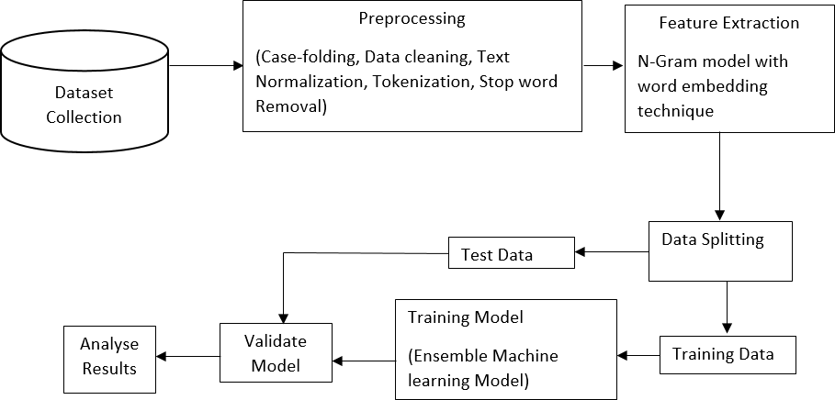
Work flow of the system

Slide 12
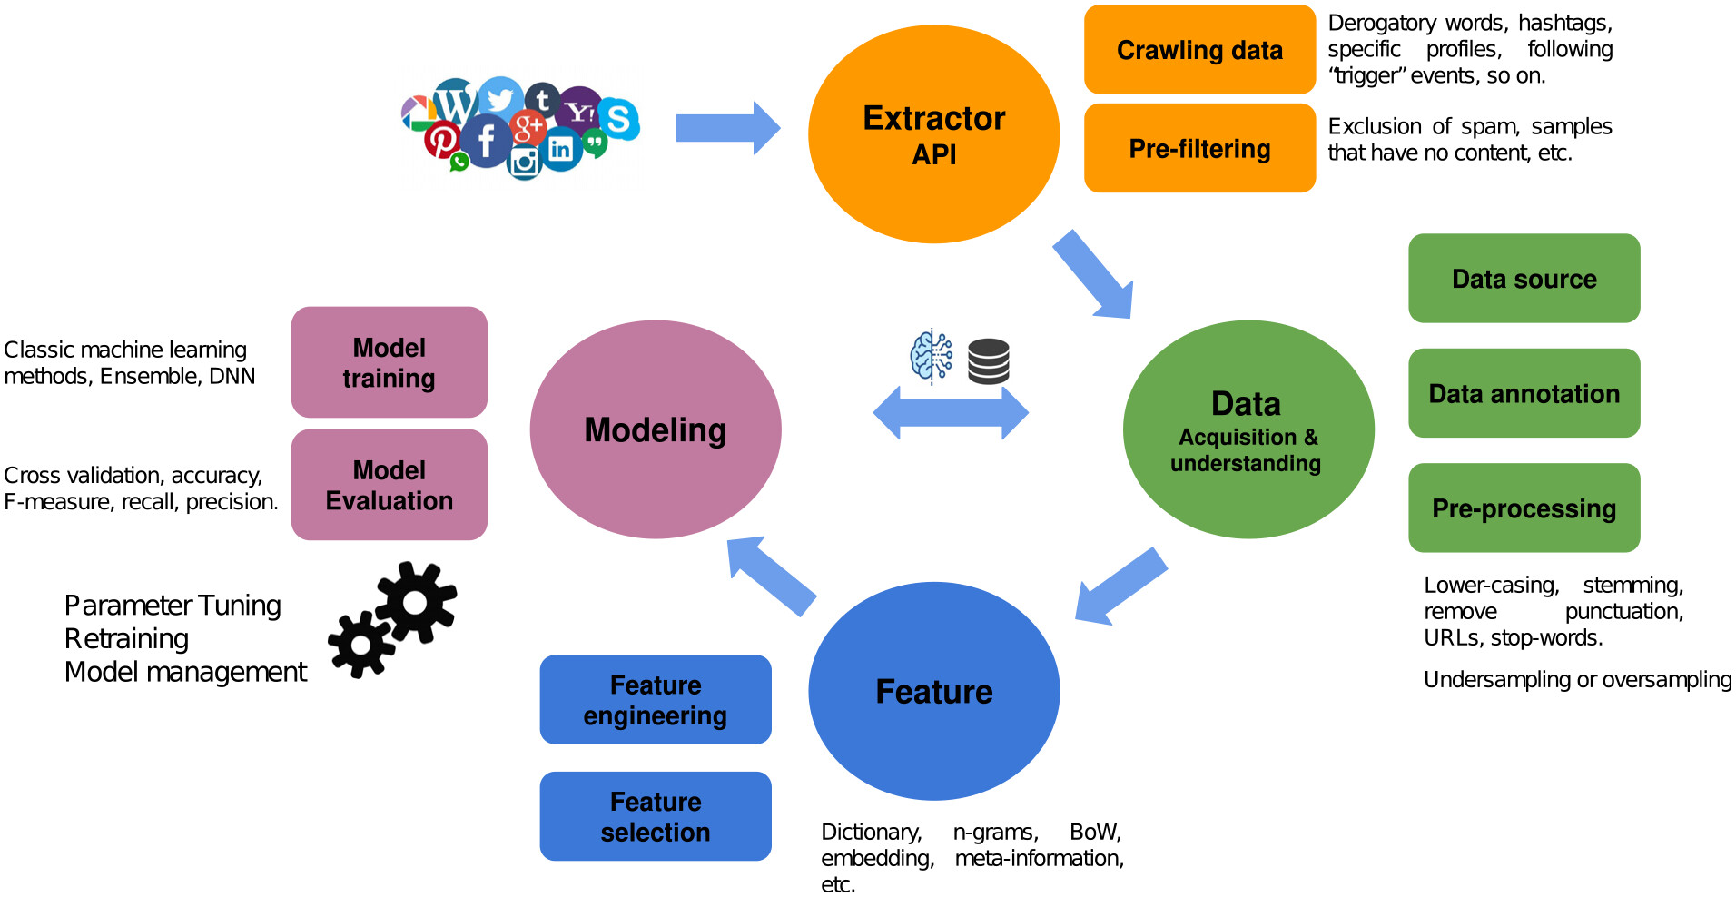
DESIGN ARCHITECTURE

Slide 13
IMPLEMENTATION
This proposed model is a prototype for a Cyberbullying detection system which can be used for social media platforms for automated checking and control of Hate speech. The data for training is cleansed and preprocessed before being fed into stacked word embeddings. Then the CNN-BiLSTM deep learning model is trained to perform better than regular deep learning models trained standalone.
Dataset Analysis - The acquired labeled data in 3 languages, i.e., Hindi, English and Hinglish, from numerous open-source dataset sources go towards the text preprocessing stage which involves Data Cleaning, Data Integration, Data Transformation, Data Reduction and Data discretization.
Data Cleaning - Any irrelevant attributes, empty cells and NaN values are removed. The data is also formatted so that the data type across the dataset is uniform.
Data Transformation - As the three datasets are acquired from different sources, compiling them in their original form will not be compatible because of the difference in classification labels. To proceed with these datasets, it is important to get rid of different label sets and using one single classification technique, 0-1 classifier, which will tell us if the text contains content of Hate speech or not, thus making it a black and white area to train our model and eliminating any gray possibilities.

Slide 14
Data Integration - All the datesets are integrated to one csv file that is used for further text preprocessing.
Data Discretization - In this stage the data was tokenized, i.e., splitted the sentence into words for easy evaluation of data.
Data Reduction - In this text preprocessing stage, certain things are removed such urls, special characters, ‘@’ and stopped words from tweets and converted all the text into lower case. Further, stemming is performed, which is transforming a word to its root form, and lemmatization, which reduces the words to a word existing in the language. This stage helps in reducing data into its simplest possible form.

Slide 15

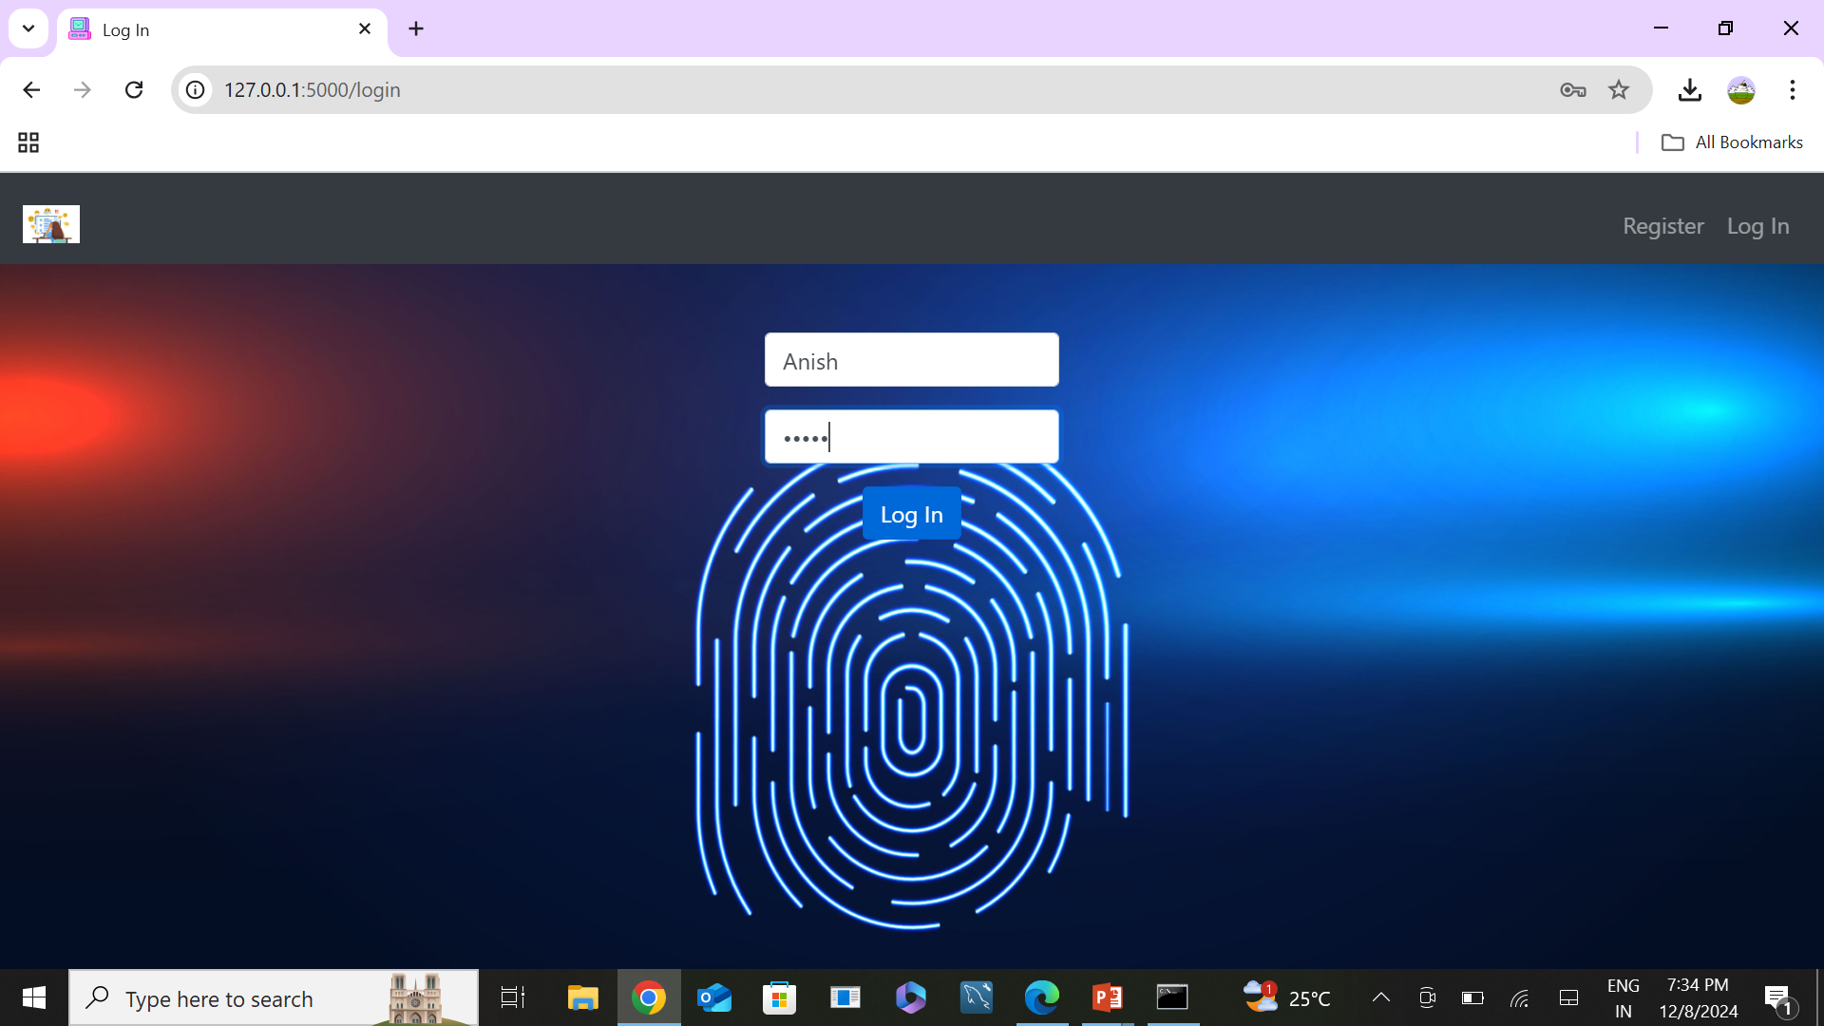
RESULTS
Fig 2: Login Page
Fig 1: Register Page

Slide 16
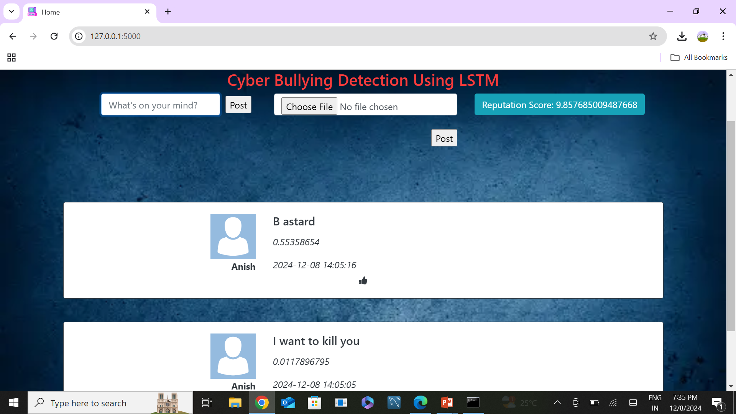
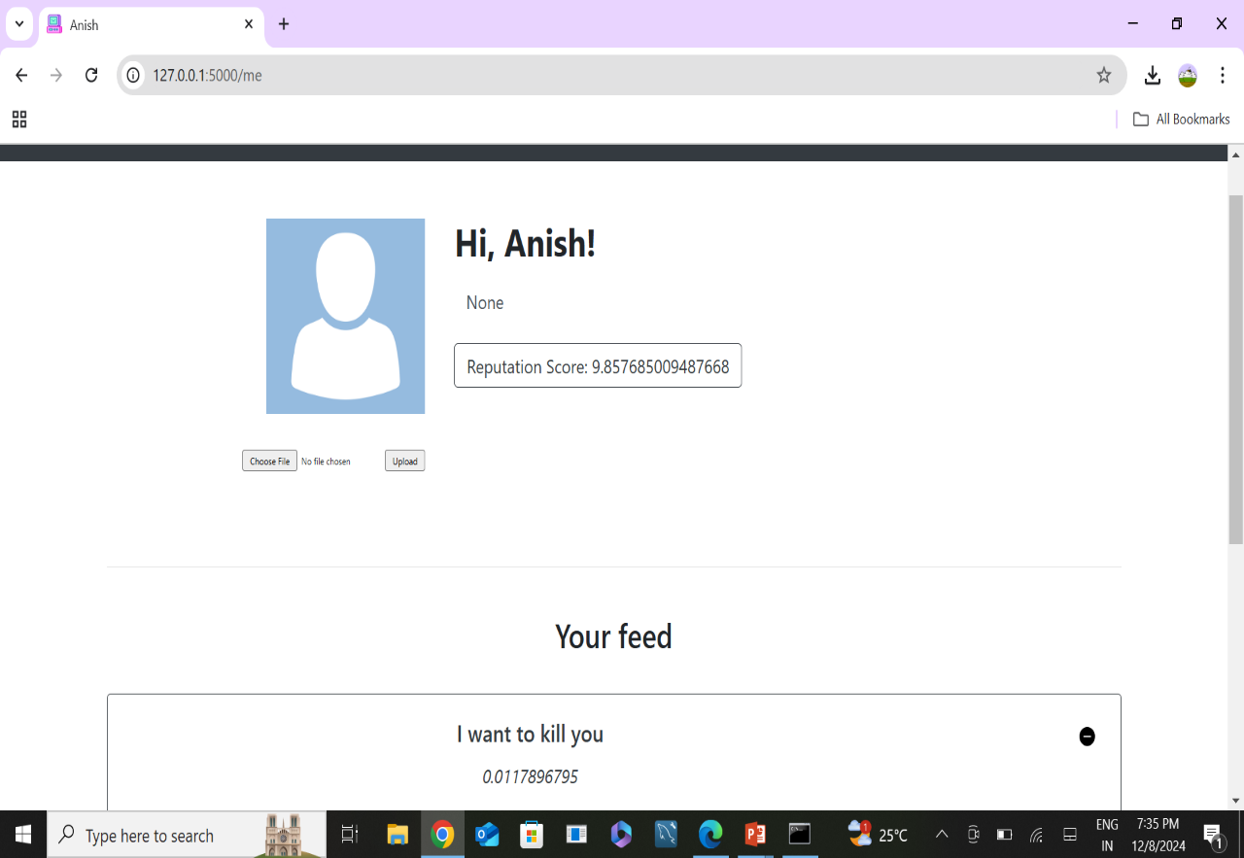
Fig 4: Profile Page
Fig 3: Post & Comments

Slide 17
APPLICATIONS
The hate speech detection system proposed here will help reduce illegal activities and communications on social media websites
Social Media Monitoring: Platforms can use hate speech detection algorithms to filter out harmful content, ensuring a safer environment for users. This helps in maintaining community standards and reducing instances of cyberbullying and harassment.
Sentiment Analysis: Businesses can leverage hate speech detection to analyze customer feedback, social media mentions, or reviews, identifying potential issues related to discrimination or negative sentiment towards specific groups.

Slide 18
ADVANTAGES
Promotes Safer Communities: Reduces harassment and fosters inclusivity online.
Legal Compliance: Helps platforms meet regulations against hate speech.
Efficiency: Automates moderation, saving time and resources.
Prevents Harm: Reduces risks of real-world violence and societal unrest.
Improves Reputation: Builds trust by maintaining a respectful user environment.
DISADVANTAGES
False Positives: Legitimate content might get flagged unfairly.
Context Challenges: Struggles with sarcasm, slang, or cultural nuances.
Algorithmic Bias: Risks perpetuating biases in training data.
Privacy Concerns: Continuous monitoring may raise ethical issues.
Technology Dependence: Lacks the nuanced understanding of human judgment.

Slide 19
CONCLUSION
The proposed system efficiently classifies code-mixed textual content provided by users into three categories: hate, non-hate, or offensive.
The system leverages Natural Language Processing (NLP) techniques, including the N-Gram model and word embedding, to extract meaningful features from the text.
NLP techniques enable the system to handle the complexity of code-mixed content, which often contains multiple languages and linguistic structures on social media platforms.
The system contributes to a safer online environment by effectively detecting hate speech and offensive content.
It tackles code-mixed text challenges, serving as a valuable tool for protecting marginalized communities and promoting responsible online communication.

Slide 20
THANK YOU

